Slide 1
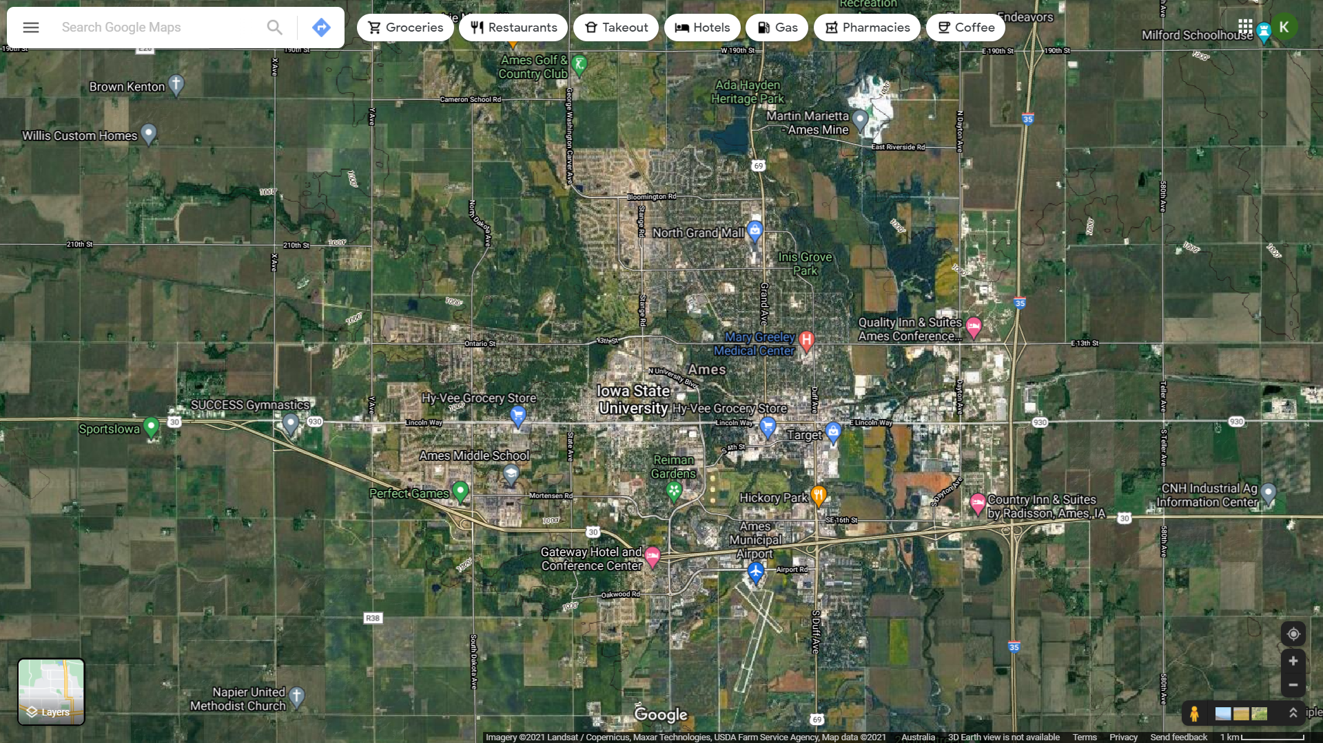
Ames Housing Data Insights
By Krisdan

Slide 2
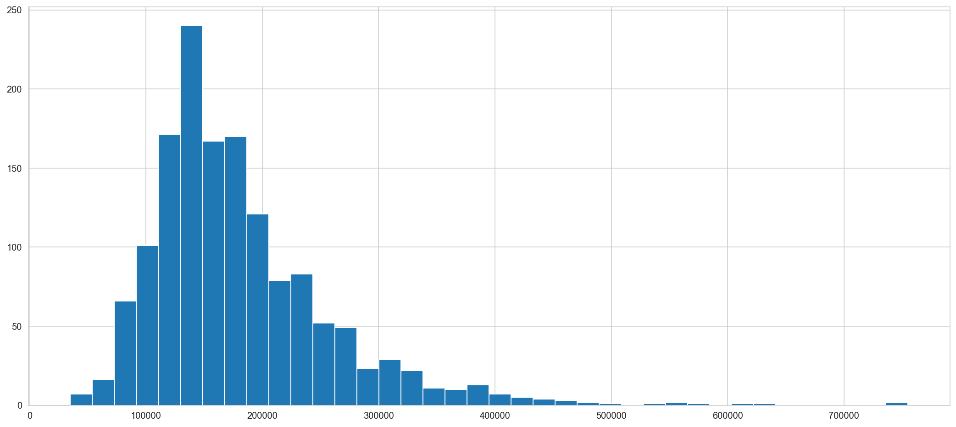
Histogram of Sale Prices
Mean = $186,277.64 Median = $165,000.00
Mode = $140,000.00
Notes:
Right-Skew

Slide 3
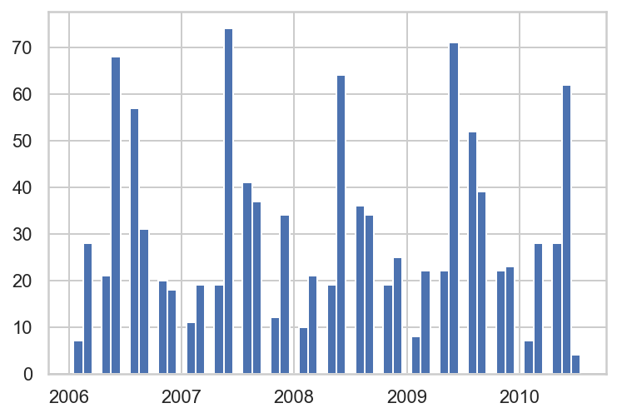
Our Training and Testing Data
house11['MoYrSold'].hist(bins = 54) Train 984
Test 129
Total 1113
Notes:
Train 984
Test 129
1113
88 – 12 Split

Slide 4
Splitting and sorting the Features (Showing Top 5 χ²)
Fixed Features (33)
Renovatable Features (54)
Lot size in square feet
Second floor square feet
Rating of basement finished area
Low quality finished square feet (all floors)
Above-ground living area square feet
Basement-finish square feet
Pool area in square feet
Enclosed porch area in square feet
Dollar-Value of any miscellaneous features
Style of dwelling: One-and-one-half story: 2nd level finished

Slide 5
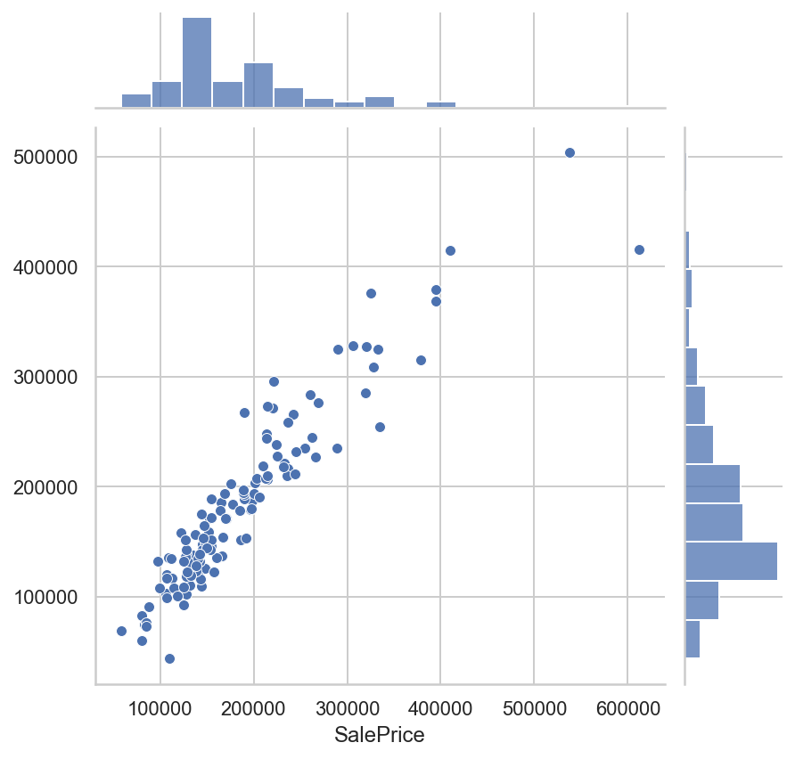
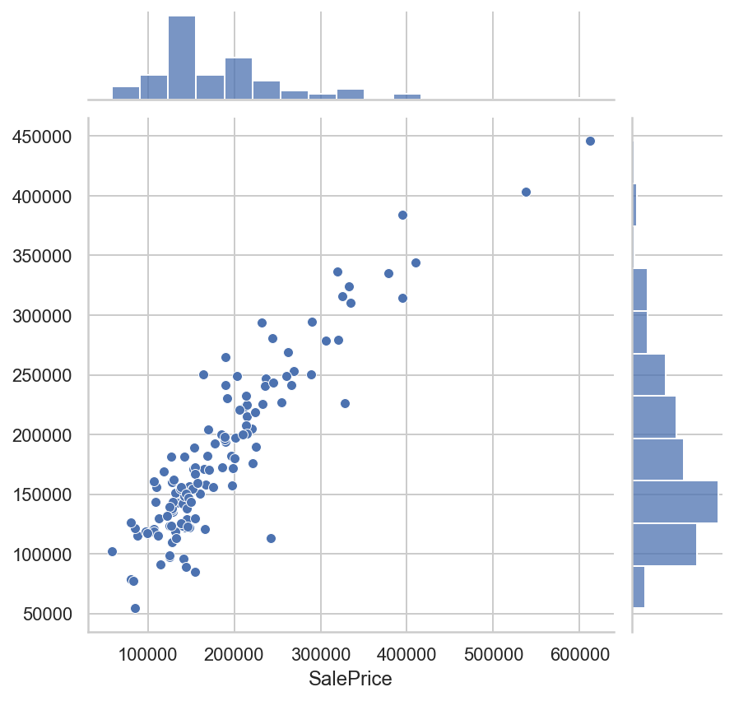
Our Prediction Models at work (and R² scores)
Fixed (87.8%)
Renovatable (81.7%)
Notes:
R-Squared measures how much variation of an output variable is explained by the input variable(s) in a regression model
Other methods used:
Cross-Validation Prediction
Calculated Optimal Ridge
Feature Selection using chi2 and f_class
R-Squared is a statistical measure of fit that indicates how much variation of a dependent variable is explained by the independent variable(s) in a regression model.
https://www.investopedia.com/terms/r/r-squared.asp

Slide 6
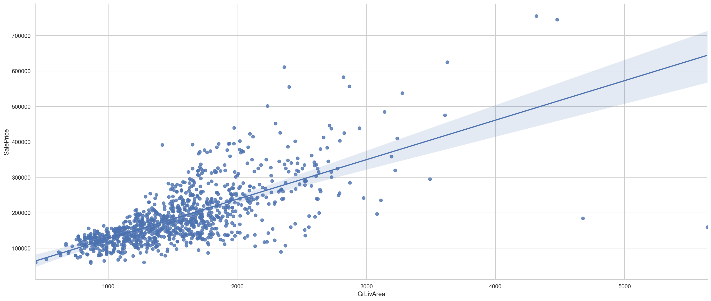
Above-ground living area (square feet) vs Sale Price
Notes:
$111.518472 per ft^2

Slide 7
Above-ground living area (square feet) vs Sale Price ($111.518472 per ft^2)
Notes:
$111.518472 per ft^2
Mention Chi-2 and F-Class (?)
Anscombe's quartet

Slide 8
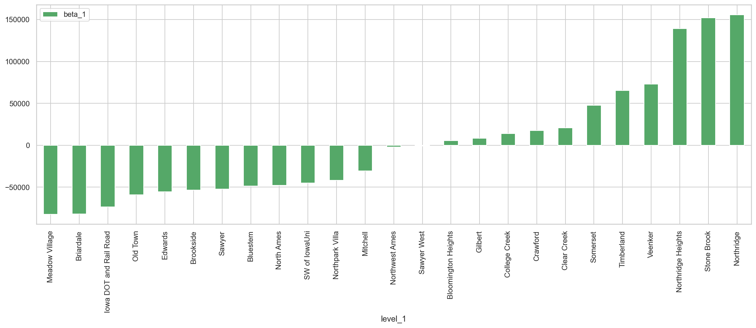
The neighbourhoods by their beta-1s

Slide 9
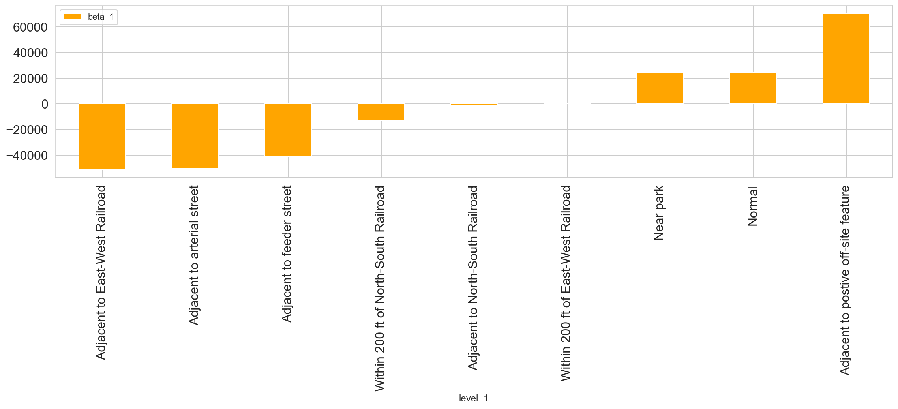
NIMBY / YIMBY
Notes:
Adjacent to postive off-site feature $70,438.79
Normal $24,605.43
Near park $23,999.76
Within 200 ft of East-West Railroad $723.01
Adjacent to North-South Railroad -$824.08
Within 200 ft of North-South Railroad -$12,763.11
Adjacent to feeder street -$41,057.50
Adjacent to arterial street -$49,954.10
Adjacent to East-West Railroad -$51,034.77

Slide 10
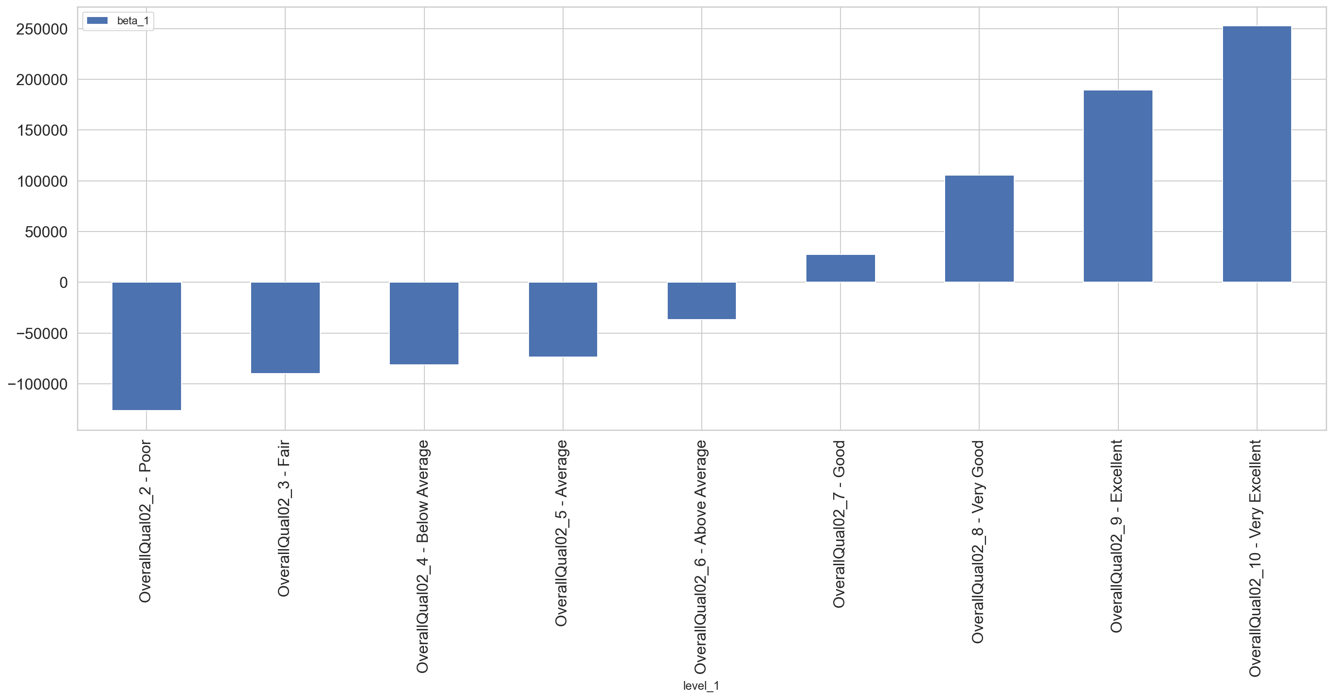
‘Overall Quality’ vs Beta-1
Notes:
level_1 beta_1
10 - Very Excellent $252,546
9 - Excellent $189,691
8 - Very Good $105,809
7 - Good $27,407
6 - Above Average -$36,901
5 - Average -$73,355
4 - Below Average -$81,331
3 - Fair -$89,938
2 - Poor -$126,391
Applied same method to

Slide 11
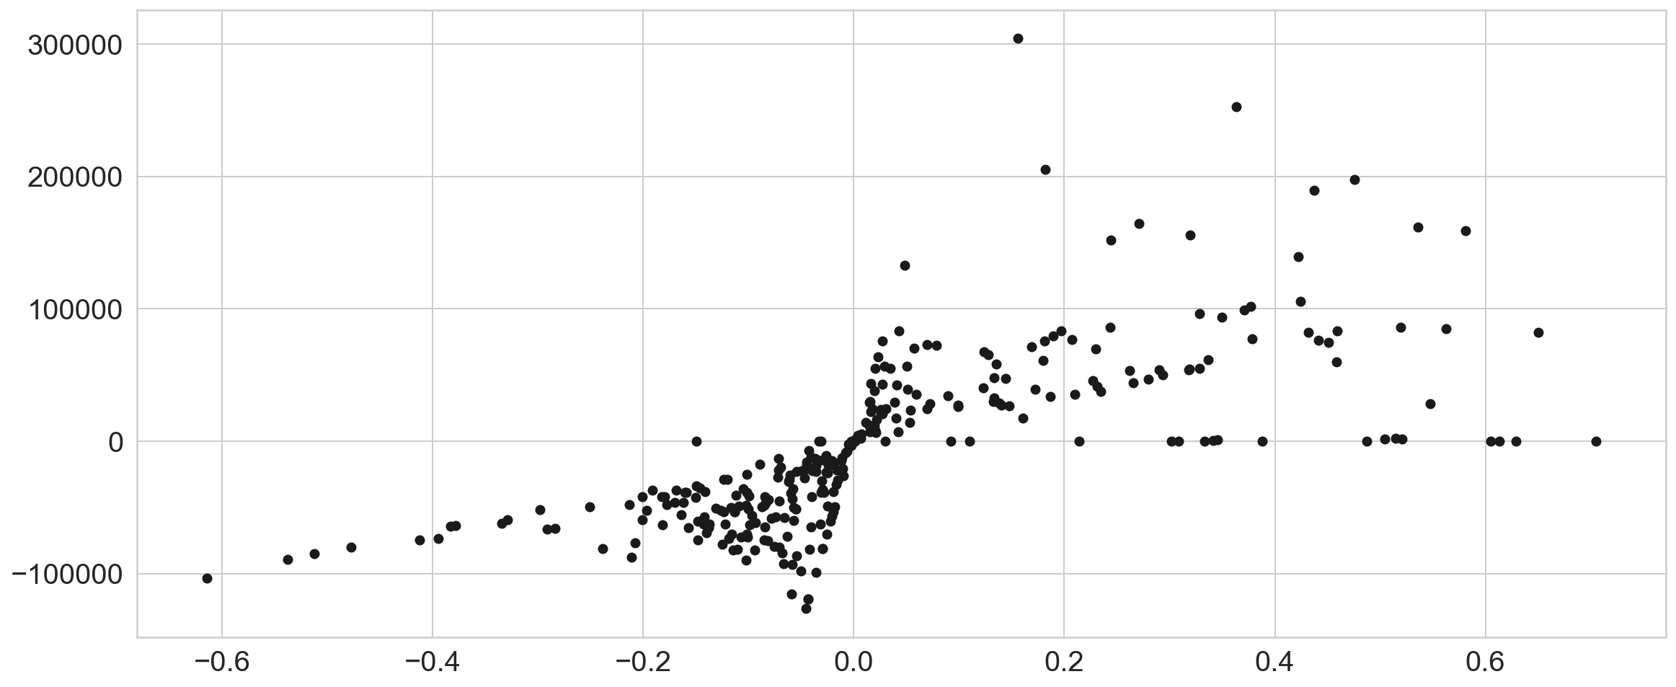
All features, correlations vs beta-1s
Notes:
Anscombe's quartet
Kitchen
Garage
Basement
Fireplace

Slide 12
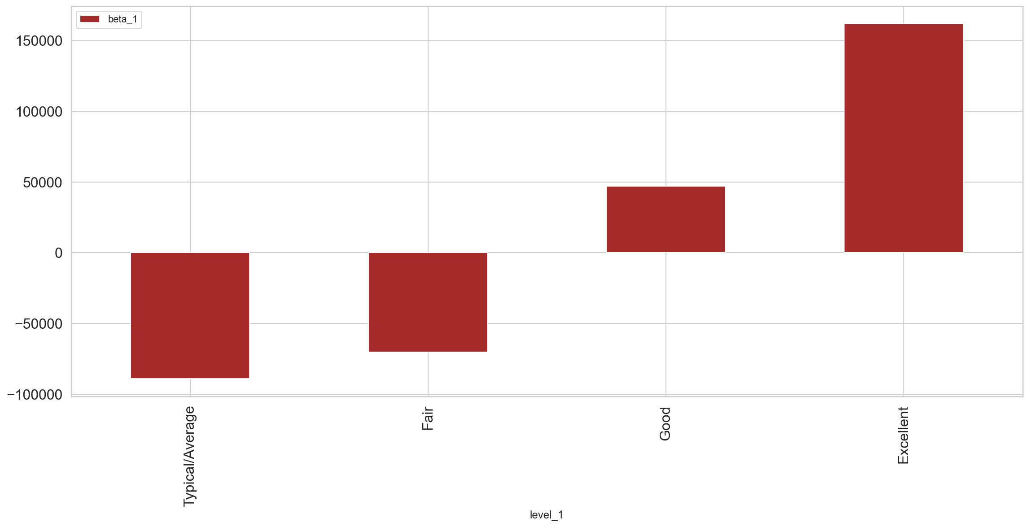
Kitchen Quality
Notes:
Excellent $161,750.15 $114,754.71
Good $46,995.44 $117,345.68
Fair -$70,350.24 $18,704.53
Typical/Average -$89,054.77 $0.00

Slide 13
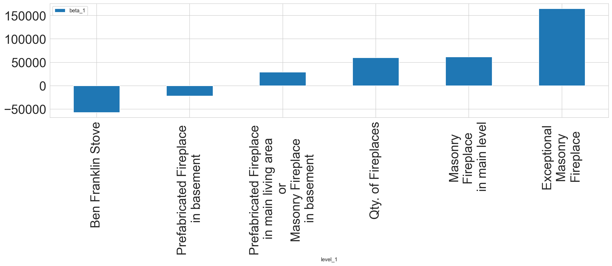
Fireplaces’ beta-1s
Notes:
Qty. of Fireplaces $59,918.87
Exceptional Masonry Fireplace $164,570.31
Masonry Fireplace in main level $61,637.76
Qty. of Fireplaces $59,918.87
Prefabricated Fireplace in main living area or Masonry Fireplace in basement $28,951.34
Prefabricated Fireplace in basement -$22,302.31
Ben Franklin Stove -$57,309.88

Slide 14
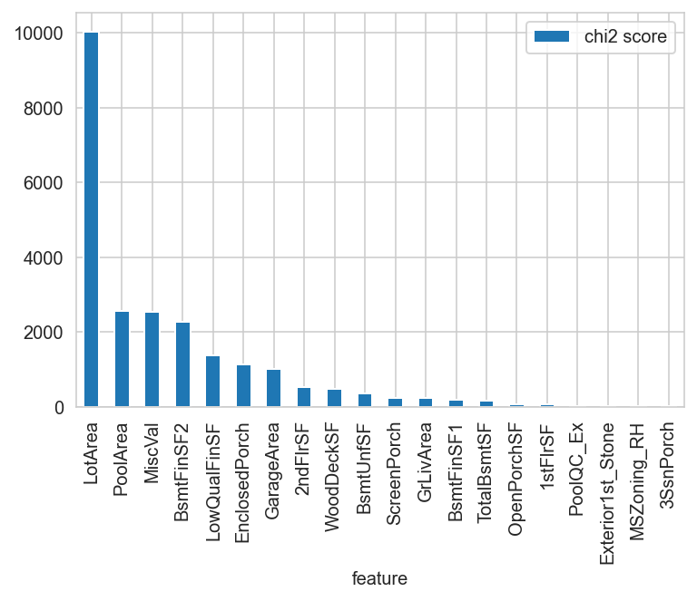
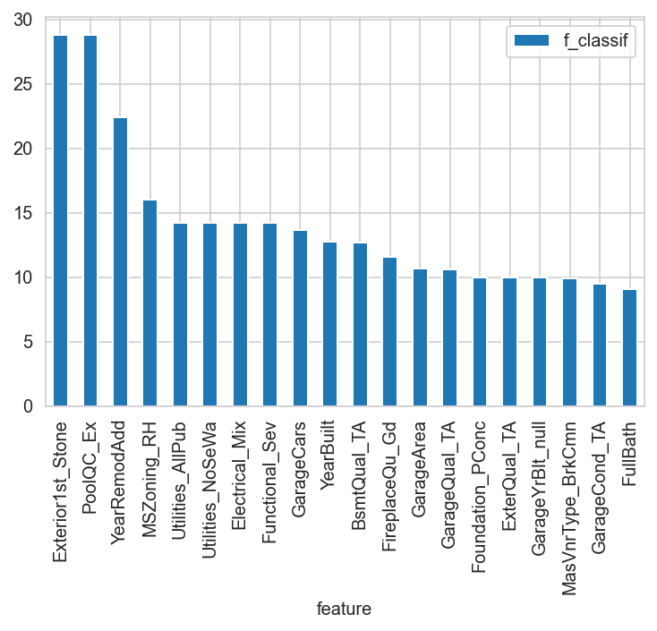
Abnormal Sale Conditions
Notes:
If you ever do attempt to build a predicter include:
2-colour scatter plot
Confusion matrix

Slide 15
The End

Slide 16
The End
Any questions?

Slide 17
Splitting and sorting the Features
Fixed Features (33)
Renovatable Features (54)
Lot size
Type of dwelling
One story
Two story
Split Foyer
Split Level
Neighbourhood
Kitchen Quality
GarageFinish
Attached to home
Basement Garage
Car Port
Basement Condition

Slide 19
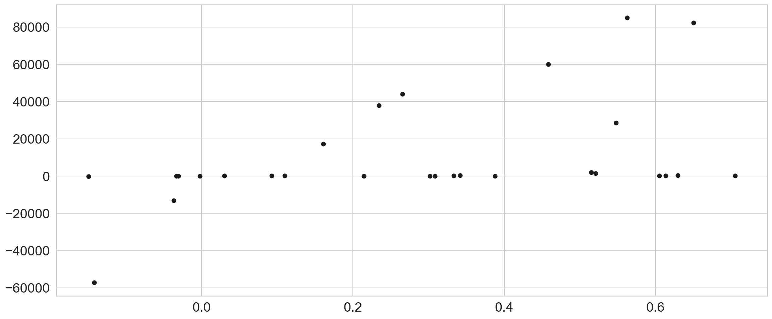
Int64 corr x beta_1
Notes:
Fireplaces FullBath GarageCars
KitchenAbvGrMSSubClass

Slide 20
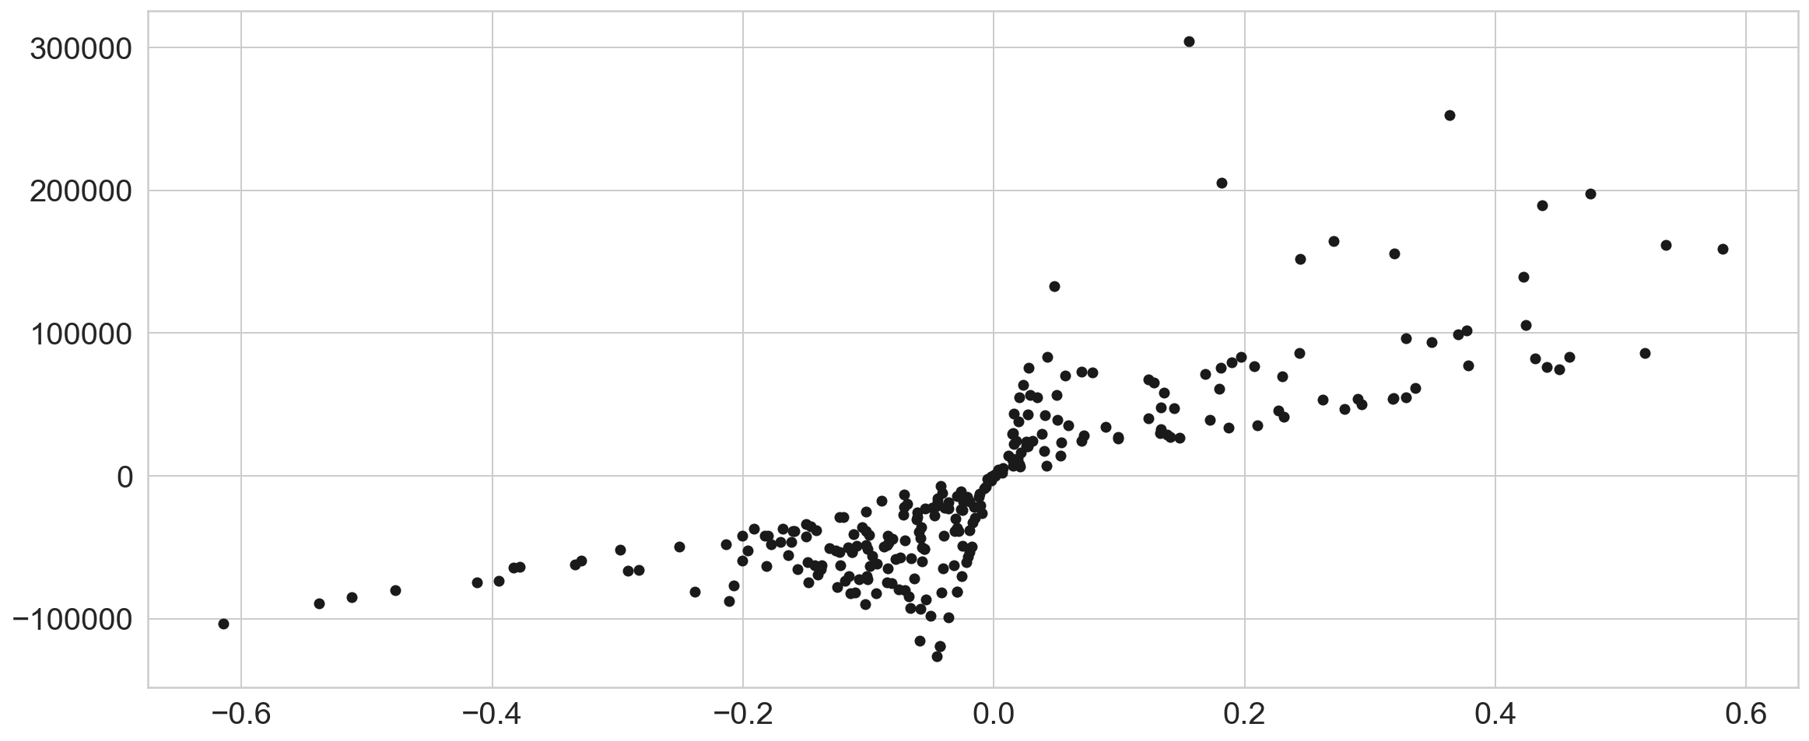
All Features: Correlation vs beta_1
Notes:
Explain extreme ends
KitchenQual

Slide 21
Estimate the sale price of properties based on their "fixed" characteristics, such as neighborhood, lot size, number of stories

Slide 22
Estimate the impact of possible renovations to properties from the variation in sale price not explained by the fixed characteristics

Slide 23
Bonus Question: Determine the features in the housing data that best predict "abnormal" sales (foreclosures, etc.)

Slide 24
Determine any value of changeable property characteristics unexplained by the fixed ones

Slide 25
What property characteristics predict an "abnormal" sale

